Slide 1
Ethernet
Network Fundamentals – Chapter 9

Slide 2
Objectives
Identify the basic characteristics of network media used in Ethernet.
Describe the physical and data link features of Ethernet.
Describe the function and characteristics of the media access control method used by Ethernet protocol.
Explain the importance of Layer 2 addressing used for data transmission and determine how the different types of addressing impacts network operation and performance.
Compare and contrast the application and benefits of using Ethernet switches in a LAN as apposed to using hubs.
Explain the ARP process.

Slide 3
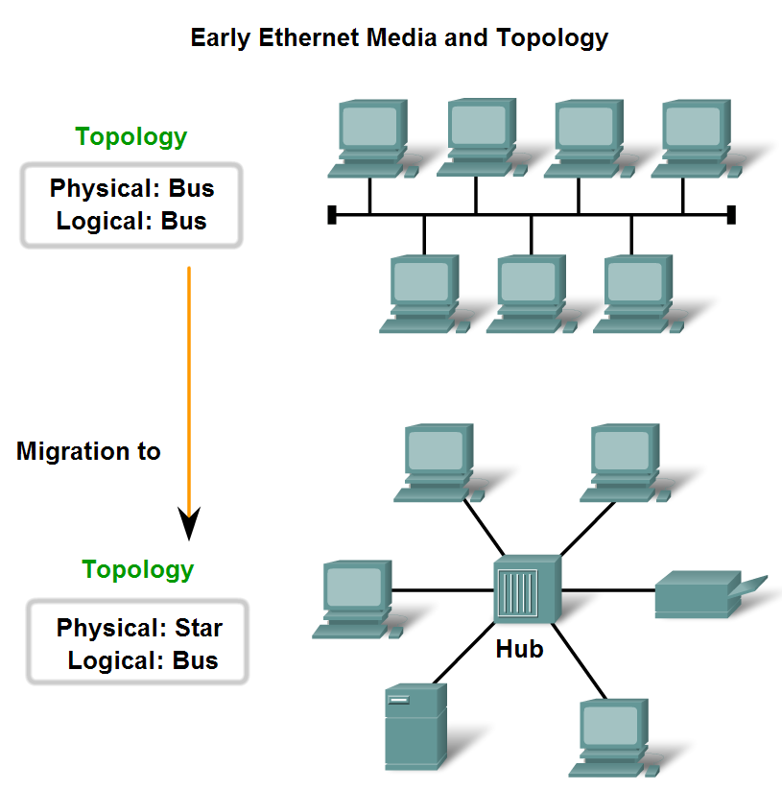
Characteristics of Network Media used in Ethernet
Identify several characteristics of Ethernet in its early years.

Slide 4
Earlier Ethernet
The first versions of Ethernet used coaxial cable to connect computers in a bus topology.
Each computer was directly connected to the backbone. These early versions of Ethernet were known as Thicknet, (10BASE5) and Thinnet (10BASE2).
10BASE5, or Thicknet, used a thick coaxial that allowed for cabling distances of up to 500 meters before the signal required a repeater.
10BASE2, or Thinnet, used a thin coaxial cable that was smaller in diameter and more flexible than Thicknet and allowed for cabling distances of 185 meters.
The early implementations of Ethernet were deployed in a low-bandwidth LAN environment where access to the shared media was managed by CSMA, and later CSMA/CD

Slide 5
Later Implementations
The physical topology was also changed to a star topology using hubs.
Hubs concentrate connections - they take a group of nodes and allow the network to see them as a single unit.
When a frame arrives at one port, it is copied to the other ports so that all the segments on the LAN receive the frame.
Using the hub in this bus topology increased network reliability by allowing any single cable to fail without disrupting the entire network.
However, repeating the frame to all other ports did not solve the issue of collisions.

Slide 6
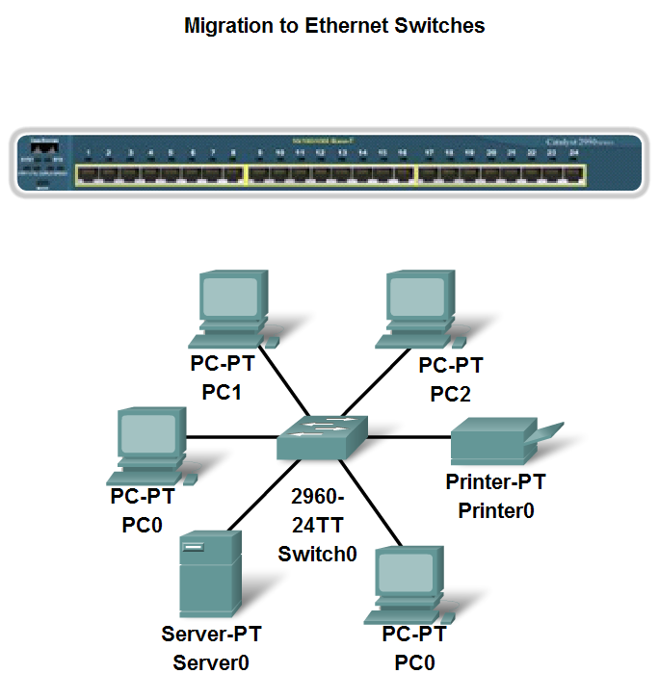
Characteristics of Network Media used in Ethernet
Describe the emergence of the LAN switch as a key innovation for managing collisions on Ethernet-based networks

Slide 7
Legacy Ethernet
In 10BASE-T networks, typically the central point of the network segment was a hub.
This created a shared media. Because the media is shared, only one station could successfully transmit at a time.
This type of connection is described as a half-duplex communication.
During periods of low communications activity, the few collisions that occur are managed by CSMA/CD, with little or no impact on performance.
As the number of devices and subsequent data traffic increase, however, the rise in collisions can have a significant impact on the user's experience.

Slide 8
Current Ethernet
A significant development was the introduction of switches to replace hubs in Ethernet-based networks.
This development closely corresponded with the development of 100BASE-TX Ethernet.
Switches can control the flow of data by isolating each port and sending a frame only to its proper destination (if the destination is known), rather than send every frame to every device.
The switch reduces the number of devices receiving each frame, which in turn reduces or minimizes the possibility of collisions.

Slide 9
Gigabit-Ethernet
Gigabit Ethernet is used to describe Ethernet implementations that provide bandwidth of 1000 Mbps (1 Gbps) or greater.
This capacity has been built on the full-duplex capability and the UTP and fiber-optic media technologies of earlier Ethernet.
The increase in network performance is significant when potential throughput increases from 100 Mbps to 1 Gbps and above.
Upgrading to 1 Gbps Ethernet does not always mean that the existing network infrastructure of cables and switches has to be completely replaced.
Some of the equipment and cabling in modern, well-designed and installed networks may be capable of working at the higher speeds with only minimal upgrading.

Slide 10
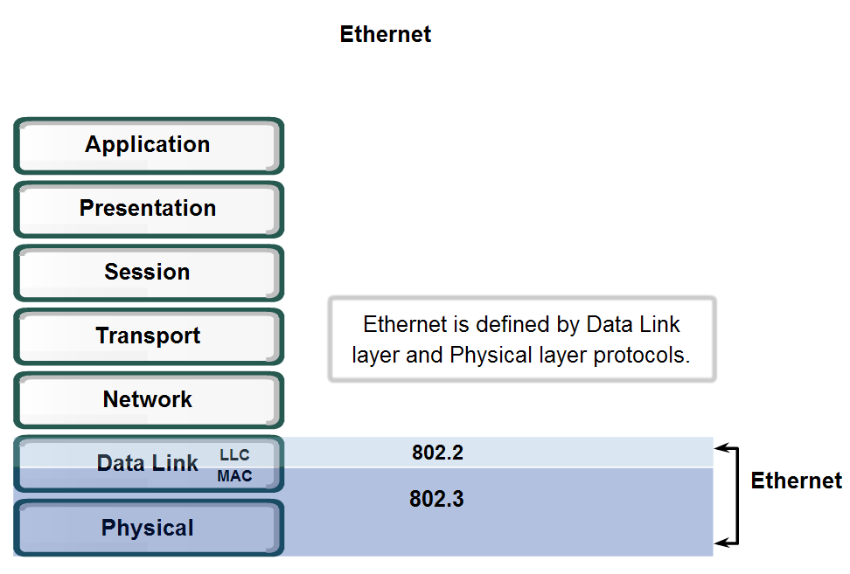
Physical and Data Link Features of Ethernet
Standards and Implementation

Slide 11
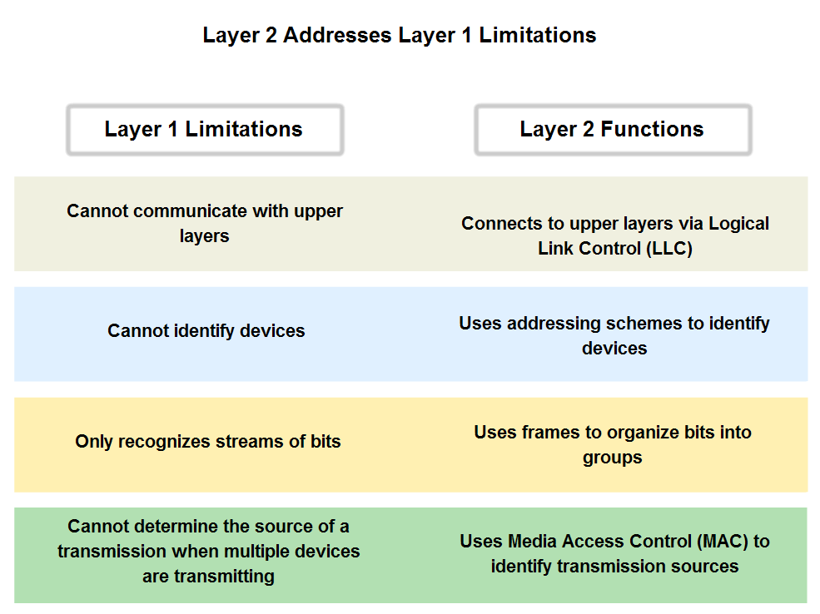
Physical and Data Link Features of Ethernet
Describe how the Ethernet operates across two layers of the OSI model

Slide 12
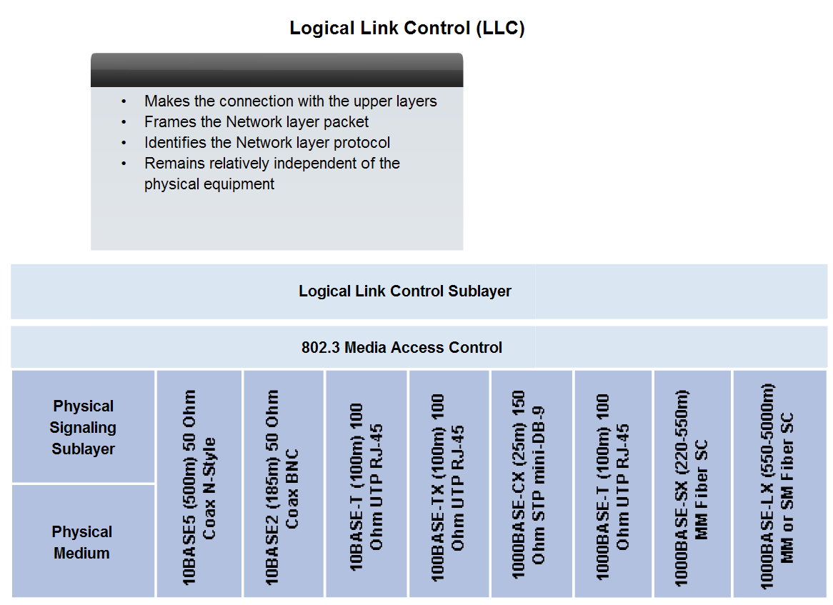
Physical and Data Link Features of Ethernet
Logic Link Control – Connecting the Upper Layers

Slide 13
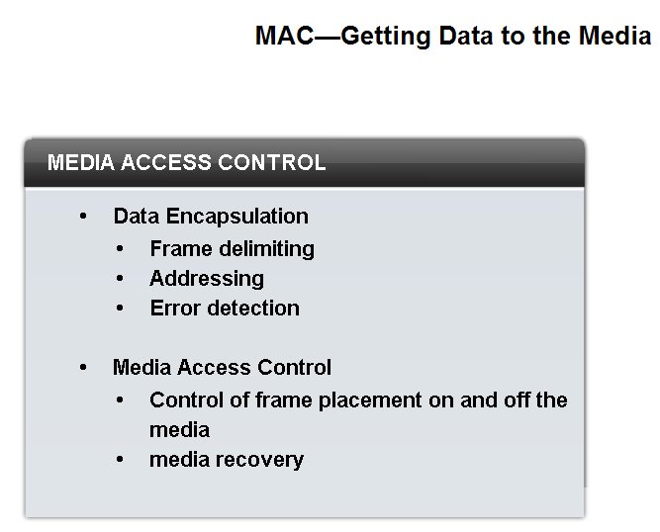
Physical and Data Link Features of Ethernet
Media Access Control (MAC)

Slide 14
Data Encapsulation
Data encapsulation provides three primary functions:
Frame delimiting
Addressing
Error detection
The data encapsulation process includes frame assembly before transmission and frame parsing upon reception of a frame.
In forming the frame, the MAC layer adds a header and trailer to the Layer 3 PDU.
The use of frames aids in the transmission of bits as they are placed on the media and in the grouping of bits at the receiving node.
The framing process provides important delimiters that are used to identify a group of bits that make up a frame.
This process provides synchronization between the transmitting and receiving nodes.

Slide 15
Data Encapsulation – Addressing/Error Control
The encapsulation process also provides for Data Link layer addressing.
Each Ethernet header added in the frame contains the physical address (MAC address) that enables a frame to be delivered to a destination node.
An additional function of data encapsulation is error detection.
Each Ethernet frame contains a trailer with a cyclic redundancy check (CRC) of the frame contents. After reception of a frame, the receiving node creates a CRC to compare to the one in the frame.
If these two CRC calculations match, the frame can be trusted to have been received without error.

Slide 16
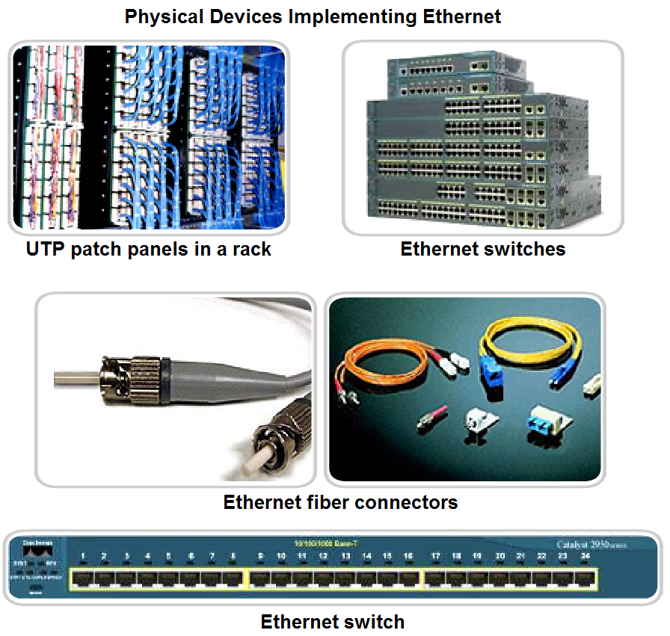
Physical and Data Link Features of Ethernet
Physical Implementations of the Ethernet

Slide 17
Physical Aspects of Ethernet
The success of Ethernet is due to the following factors:
Simplicity and ease of maintenance
Ability to incorporate new technologies
Reliability
Low cost of installation and upgrade
As a technology associated with the Physical layer, Ethernet specifies and implements encoding and decoding schemes that enable frame bits to be carried as signals across the media.
Ethernet devices make use of a broad range of cable and connector specifications. In today's networks, Ethernet uses UTP copper cables and optical fiber to interconnect network devices via intermediary devices such as hubs and switches.

Slide 18
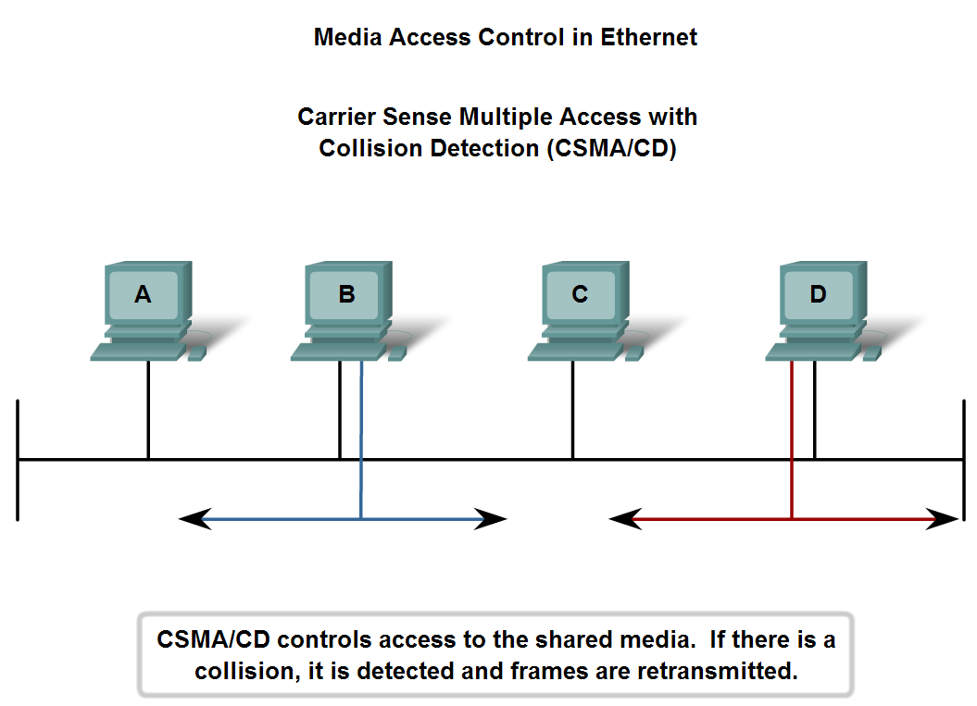
Function and Characteristics of the Media Access Control Method
MAC in Ethernet

Slide 19
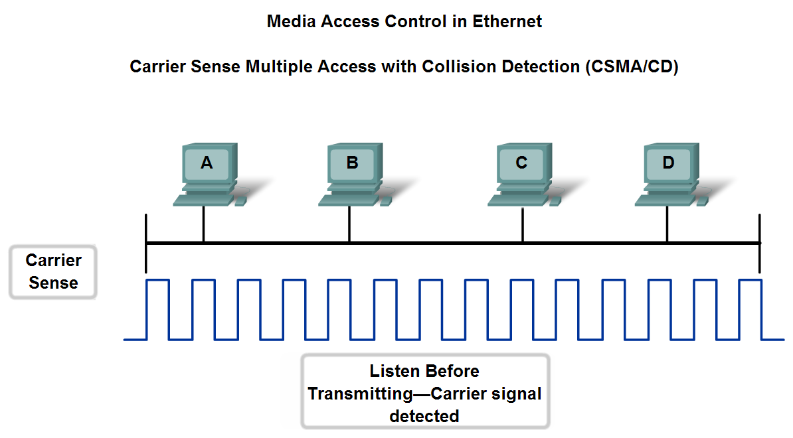
Function and Characteristics of the Media Access Control Method
Carrier Sense Multiple Access with Collision Detection

Slide 20
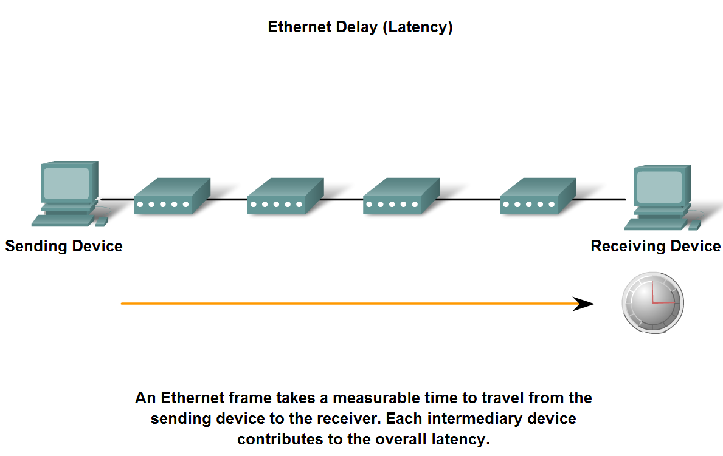
Function and Characteristics of the Media Access Control Method
Ethernet Timing

Slide 21
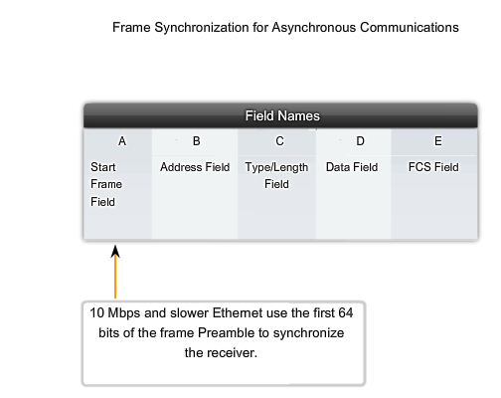
Preamble

Slide 22
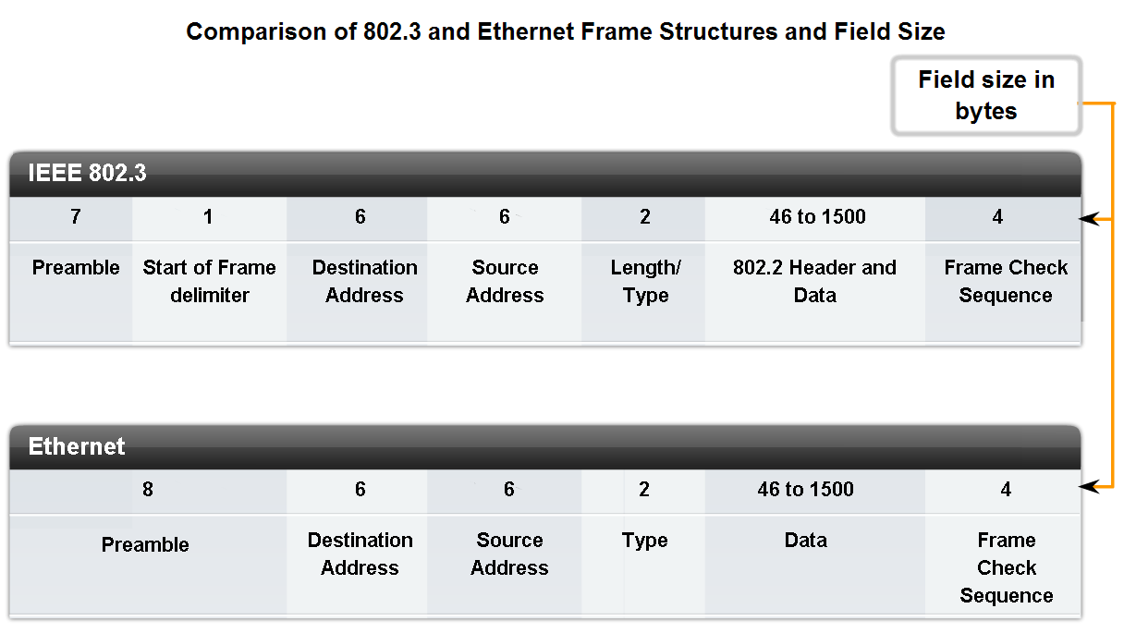
Layer 2 addressing and its Impact on Network Operation and Performance
The Frame – Encapsulating the Packet

Slide 23
Frame Size
Both the Ethernet II and IEEE 802.3 standards define the minimum frame size as 64 bytes and the maximum as 1518 bytes.
This includes all bytes from the Destination MAC Address field through the Frame Check Sequence (FCS) field.
The Preamble and Start Frame Delimiter fields are not included when describing the size of a frame. The IEEE 802.3ac standard, released in 1998, extended the maximum allowable frame size to 1522 bytes.
If the size of a transmitted frame is less than the minimum or greater than the maximum, the receiving device drops the frame.
Dropped frames are likely to be the result of collisions or other unwanted signals and are therefore considered invalid.

Slide 24
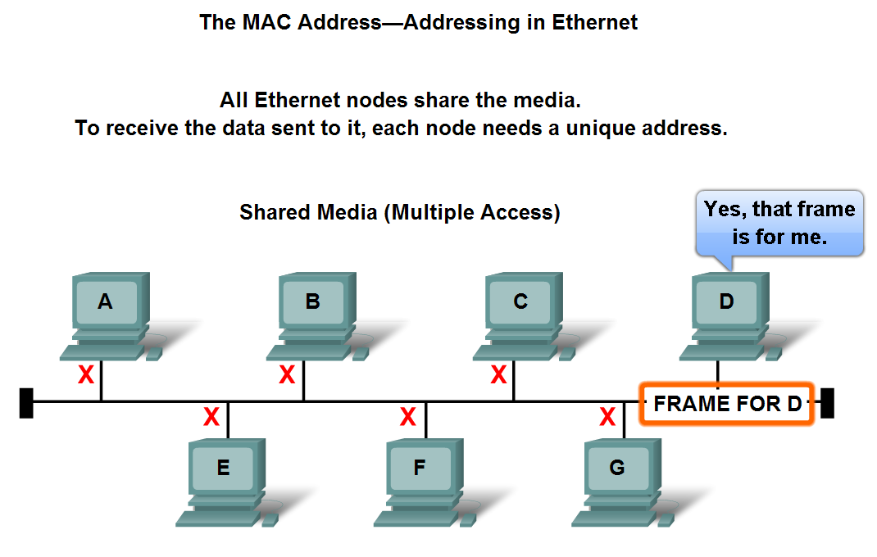
Layer 2 addressing and its Impact on Network Operation and Performance
The Ethernet MAC Address

Slide 25
MAC Addressing
A unique identifier called a Media Access Control (MAC) address was created to assist in determining the source and destination address within an Ethernet network.
Regardless of which variety of Ethernet was used, the naming convention provided a method for device identification at a lower level of the OSI model.
The MAC address value is a direct result of IEEE-enforced rules for vendors to ensure globally unique addresses for each Ethernet device.
The rules established by IEEE require any vendor that sells Ethernet devices to register with IEEE. The IEEE assigns the vendor a 3-byte code, called the Organizationally Unique Identifier (OUI).

Slide 26
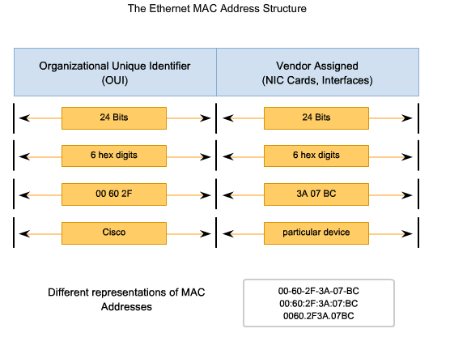
MAC Address Structure

Slide 27
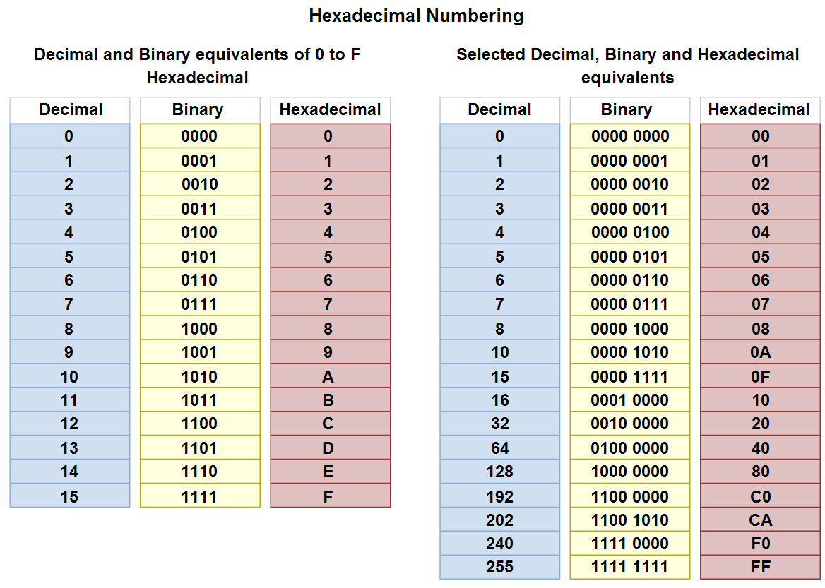
Layer 2 addressing and its Impact on Network Operation and Performance
Hexadecimal Numbering and Addressing

Slide 28
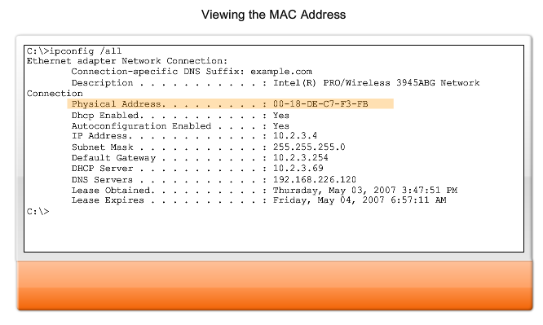
IPCONFIG /all

Slide 29
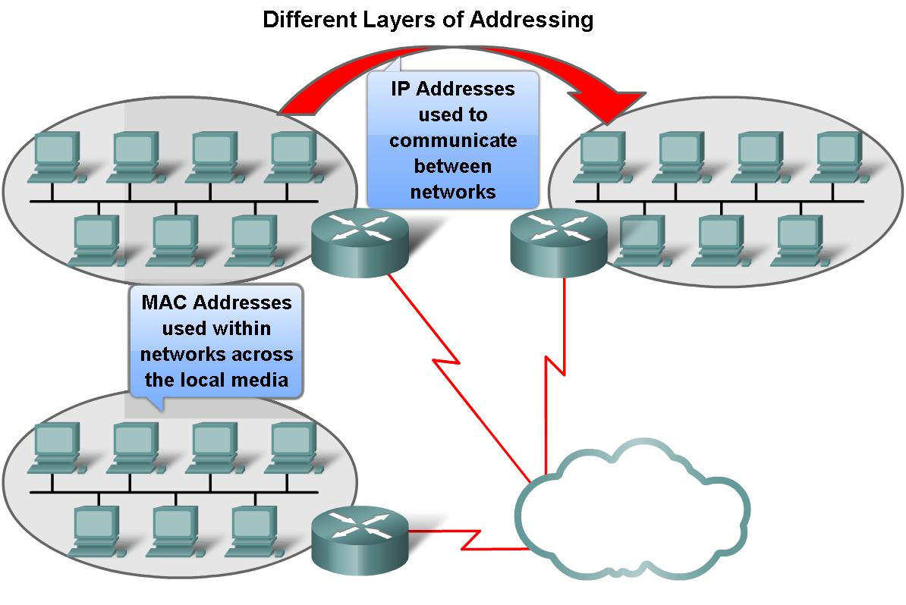
Layer 2 addressing and its Impact on Network Operation and Performance
Another Layer of Addressing

Slide 30
Different Addressing
In a nutshell:
The Network layer address enables the packet to be forwarded toward its destination.
The Data Link layer address enables the packet to be carried by the local media across each segment.

Slide 31
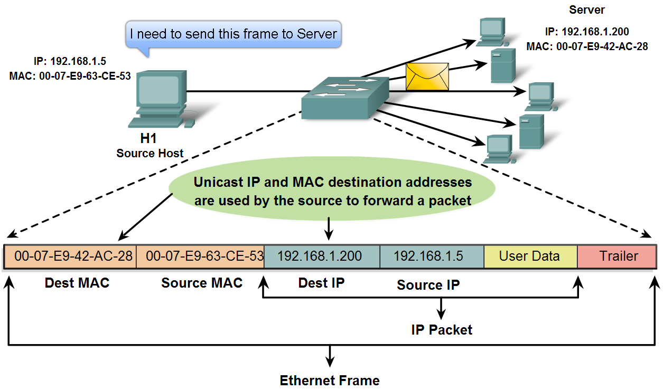
Layer 2 addressing and its Impact on Network Operation and Performance
Ethernet Unicast, Multicast and Broadcast

Slide 32
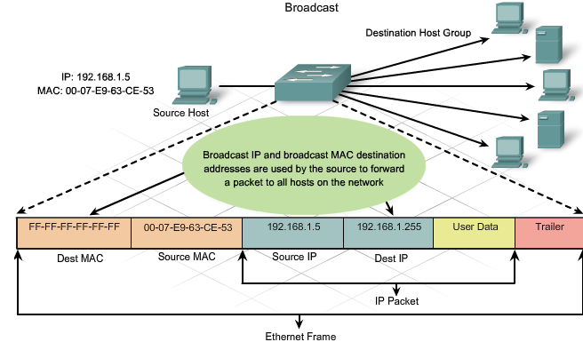
Broadcast

Slide 33
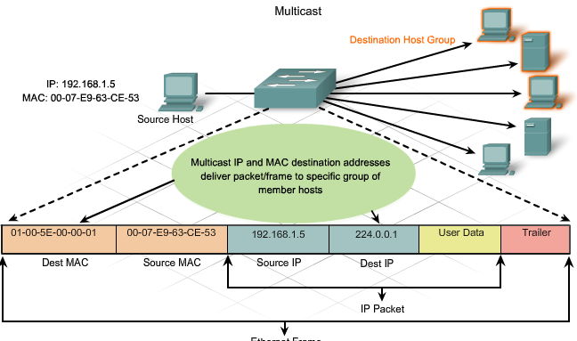
Multicast

Slide 34
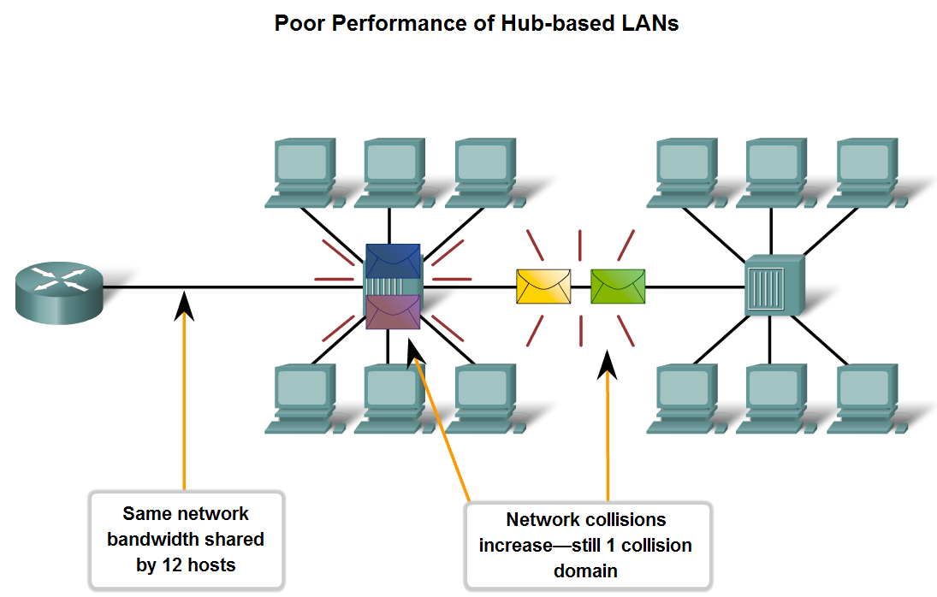
Compare and Contrast the Use of Ethernet Switches versus Hubs in a LAN.
Legacy Ethernet – Using Hubs

Slide 35
Legacy Ethernet – Performance Issues
Scalability - With each device added to the shared media, the average bandwidth available to each device decreases. With each increase in the number of devices on the media, performance is degraded.
Latency - Latency can increase significantly as the distance between nodes is extended.
Latency is also affected by a delay of the signal across the media as well as the delay added by the processing of the signals through hubs and repeaters.
Increasing the length of media or the number of hubs and repeaters connected to a segment results in increased latency. With greater latency, it is more likely that nodes will not receive initial signals, thereby increasing the collisions present in the network.

Slide 36
Legacy Ethernet
Network Failure - Because classic Ethernet shares the media, any device in the network could potentially cause problems for other devices.
If any device connected to the hub generates detrimental traffic, the communication for all devices on the media could be impeded. This harmful traffic could be due to incorrect speed or full-duplex settings on a NIC.
Collisions - If two nodes send packets at the same time, a collision occurs and the packets are lost. Then both nodes send a jam signal, wait for a random amount of time, and retransmit their packets.
Any part of the network where packets from two or more nodes can interfere with each other is considered a collision domain. A network with a larger number of nodes on the same segment has a larger collision domain and typically has more traffic.

Slide 37
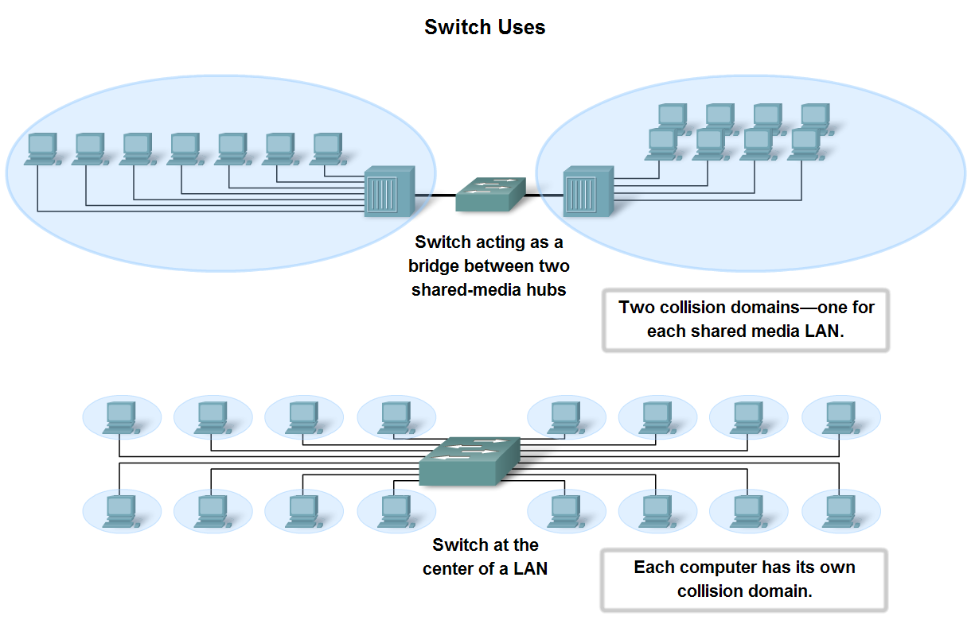
Compare and Contrast the Use of Ethernet Switches versus Hubs in a LAN.
Ethernet – Using Switches

Slide 38
Switch Uses
Switches allow the segmentation of the LAN into separate collision domains.
Each port of the switch represents a separate collision domain and provides the full media bandwidth to the node or nodes connected on that port.
With fewer nodes in each collision domain, there is an increase in the average bandwidth available to each node, and collisions are reduced.
A LAN may have a centralized switch connecting to hubs that still provide the connectivity to nodes. Or, a LAN may have all nodes connected directly to a switch. Theses topologies are shown in the figure.

Slide 39
Switch V Hubs
In a LAN where all nodes are connected directly to the switch, the throughput of the network increases dramatically. The three primary reasons for this increase are:
Dedicated bandwidth to each port
Collision-free environment
Full-duplex operation
There are three reasons why hubs are still being used:
Availability – not developed until the 90’s
Economics – rather expensive
Requirements – LANs have simple design and hubs accommodate this

Slide 40
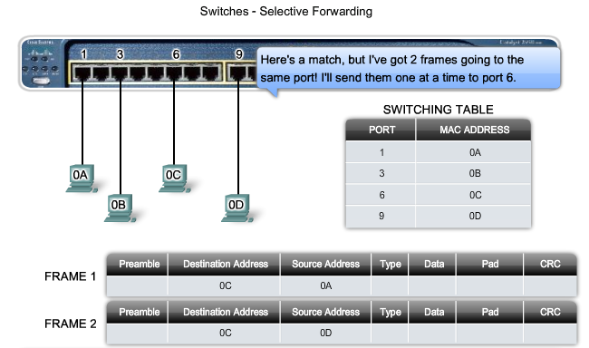
Selective Forwarding

Slide 41
Selective Switching – Store and Forward
Ethernet switches selectively forward individual frames from a receiving port to the port where the destination node is connected.
This selective forwarding process can be thought of as establishing a momentary point-to-point connection between the transmitting and receiving nodes.
The connection is made only long enough to forward a single frame.
During this instant, the two nodes have a full bandwidth connection between them and represent a logical point-to-point connection.
With store and forward switching, the switch receives the entire frame, checks the FSC for errors, and forwards the frame to the appropriate port for the destination node.
Because the nodes do not have to wait for the media to be idle, the nodes can send and receive at full media speed without losses due to collisions or the overhead associated with managing collisions.

Slide 42
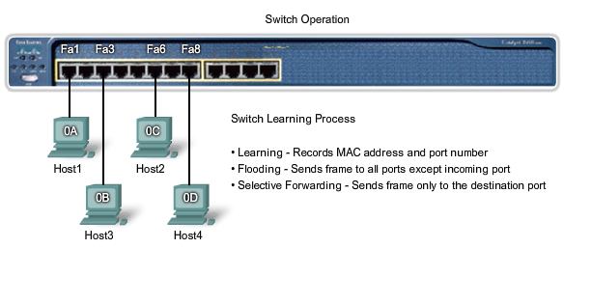
Switch Learning Process

Slide 43
Switch Operation
Learning - As each frame enters the switch, the switch examines the source MAC address. Using a lookup procedure, the switch determines if the table already contains an entry for that MAC address.
Aging - The entries in the MAC table acquired by the Learning process are time stamped. This timestamp is used as a means for removing old entries in the MAC table
Flooding - If the switch does not know to which port to send a frame because the destination MAC address is not in the MAC table, the switch sends the frame to all ports except the port on which the frame arrived.
Selective forwarding - is the process of examining a frame's destination MAC address and forwarding it out the appropriate port. This is the central function of the switch.
Filtering - In some cases, a frame is not forwarded. This process is called frame filtering. One use of filtering has already been described: a switch does not forward a frame to the same port on which it arrived. A switch will also drop a corrupt frame. If a frame fails a CRC check, the frame is dropped.

Slide 44
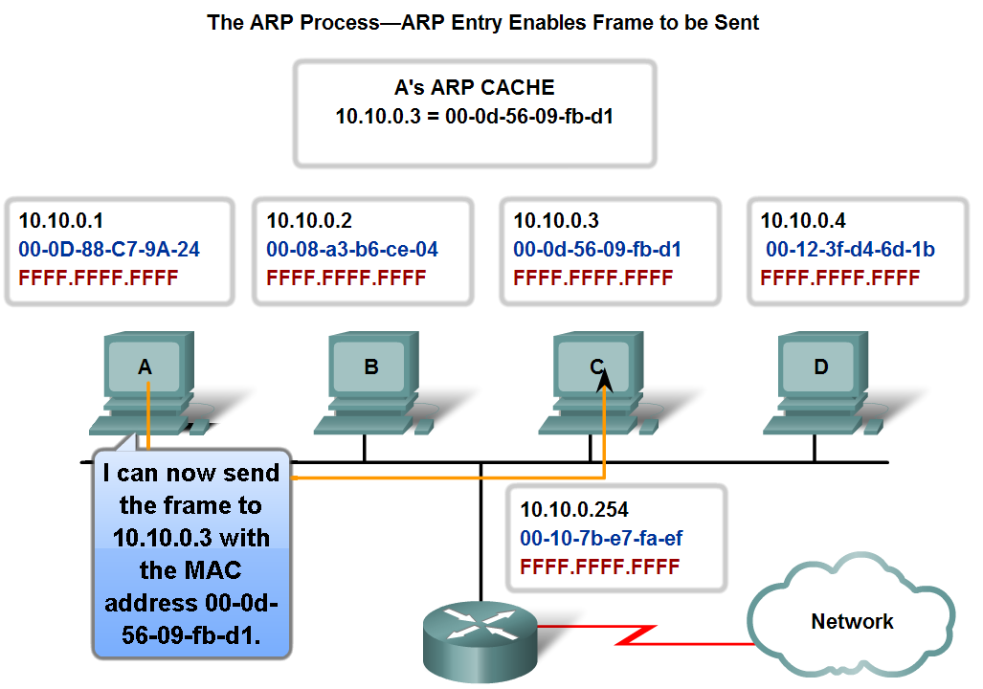
Explain the Address Resolution Protocol (ARP) process.
Mapping IP to MAC Addresses

Slide 45
Purpose of ARP
For a frame to be placed on the LAN media, it must have a destination MAC address.
When a packet is sent to the Data Link layer to be encapsulated into a frame, the node refers to a table in its memory to find the Data Link layer address that is mapped to the destination IPv4 address.
This table is called the ARP table or the ARP cache. The ARP table is stored in the RAM of the device.
To begin the process, a transmitting node attempts to locate in the ARP table the MAC address mapped to an IPv4 destination.
If this map is cached in the table, the node uses the MAC address as the destination MAC in the frame that encapsulates the IPv4 packet. The frame is then encoded onto the networking media.

Slide 46
Maintaining ARP
The ARP table is maintained dynamically. There are two ways that a device can gather MAC addresses.
One way is to monitor the traffic that occurs on the local network segment. As a node receives frames from the media, it can record the source IP and MAC address as a mapping in the ARP table.
As frames are transmitted on the network, the device populates the ARP table with address pairs.
Another way a device can get an address pair is to broadcast an ARP request. ARP sends a Layer 2 broadcast to all devices on the Ethernet LAN.
The frame contains an ARP request packet with the IP address of the destination host.

Slide 47
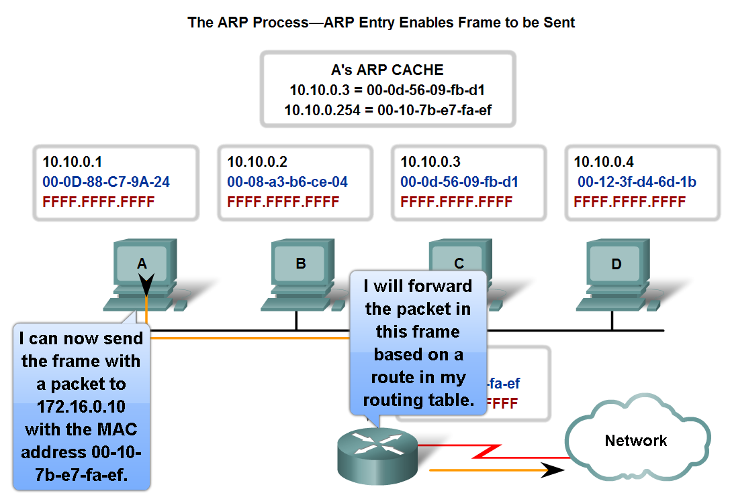
Explain the Address Resolution Protocol (ARP) process.
ARP – Destinations Outside the Local Network

Slide 48
ARP and Outside Networks
If the destination IPv4 host is not on the local network, the source node needs to deliver the frame to the router interface that is the gateway or next hop used to reach that destination.
The source node will use the MAC address of the gateway as the destination address for frames containing an IPv4 packet addressed to hosts on other networks.
The gateway address of the router interface is stored in the IPv4 configuration of the hosts.
When a host creates a packet for a destination, it compares the destination IP address and its own IP address to determine if the two IP addresses are located on the same Layer 3 network.
If the receiving host is not on the same network, the source uses the ARP process to determine a MAC address for the router interface serving as the gateway.

Slide 49
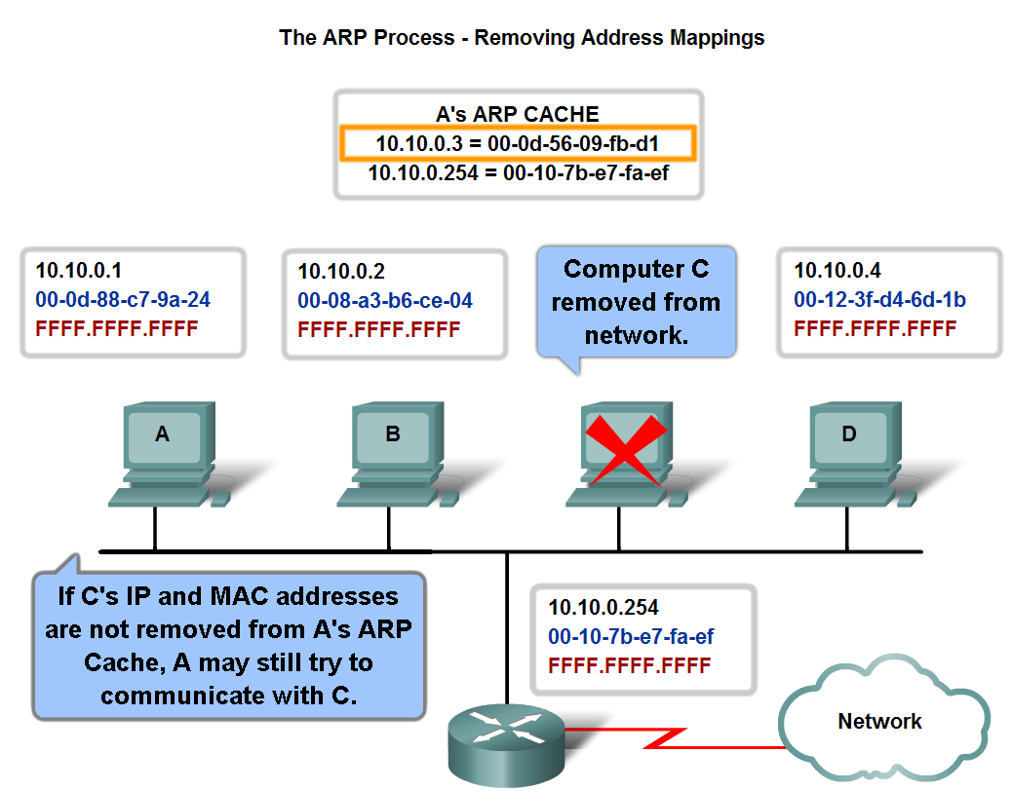
Explain the Address Resolution Protocol (ARP) process.
ARP – Removing Address Mappings

Slide 50
ARP Removal
For each device, an ARP cache timer removes ARP entries that have not been used for a specified period of time.
The times differ depending on the device and its operating system. For example, some Windows operating systems store ARP cache entries for 2 minutes.
If the entry is used again during that time, the ARP timer for that entry is extended to 10 minutes.
Commands may also be used to manually remove all or some of the entries in the ARP table.
After an entry has been removed, the process for sending an ARP request and receiving an ARP reply must occur again to enter the map in the ARP table.

Slide 51
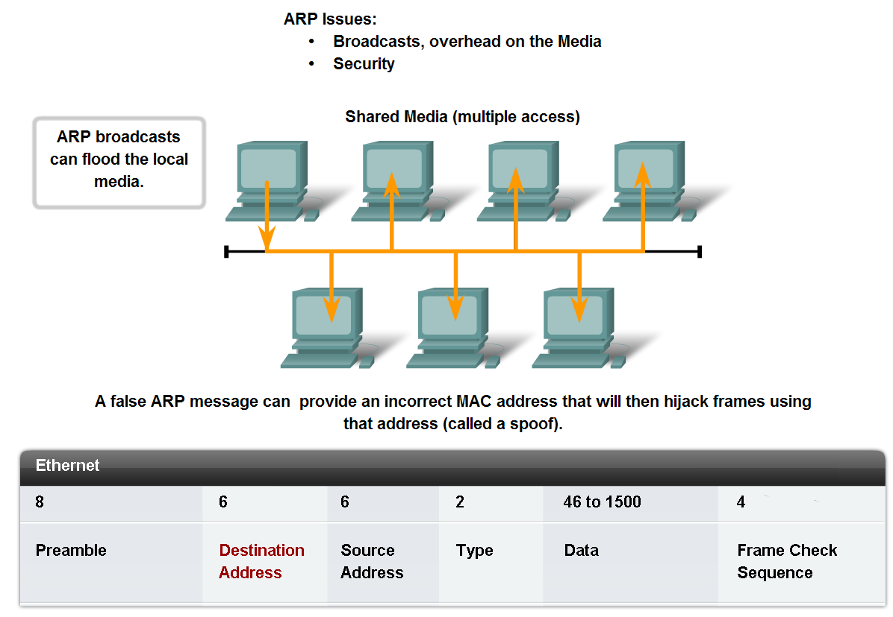
Explain the Address Resolution Protocol (ARP) process.
ARP Broadcasts - Issues

Slide 52
ARP Issues
Overhead - As a broadcast frame, an ARP request is received and processed by every device on the local network. On a typical business network, these broadcasts would probably have minimal impact on network performance.
Security - In some cases, the use of ARP can lead to a potential security risk. ARP spoofing, or ARP poisoning, is a technique used by an attacker to inject the wrong MAC address association into a network by issuing fake ARP requests. An attacker forges the MAC address of a device and then frames can be sent to the wrong destination.
Manually configuring static ARP associations is one way to prevent ARP spoofing. Authorized MAC addresses can be configured on some network devices to restrict network access to only those devices listed.

Slide 53
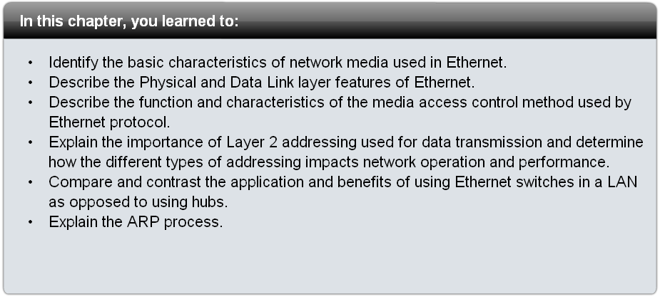
Summary

